Slide 1

Optimizing Stroke Prediction: Comparative Analysis of Machine Learning Models
Group Members
Agbanu Raphael Edem – 22428645
Agbesi Isaac – 22425055
Daniel Eshun – 22425980
Gilbert Woasieworm Adjei – 22425084
Michael Etornam Kojo Agbenyegah – 22425717
Michael Nimako Frempong – 22425053
NII Obodai squire – 22425147
Prince Obeng Nkoah – 22424742

Slide 2

Outline
Background/Problem Statement
Dataset Overview
Features in the Dataset
Handling Imbalance Classes
Methodology Pipeline
Models Compared
Model Performance Matrix
Logistic Regression
Random Forest
Support Vector Classifier (SVC)
XGBoost
Lessons Learned

Slide 3
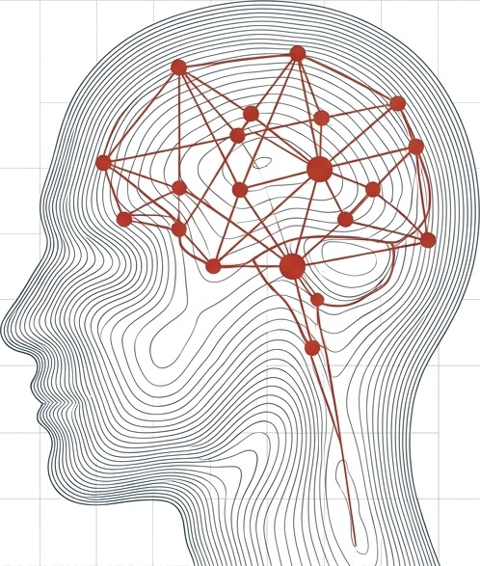

Background/Problem Statement
Stroke is a major cause of death and disability globally.
Early detection is critical for timely intervention.
Traditional models (e.g., regression) fail to capture complex patterns and in modeling nonlinear and multifactorial causes.
The goal is to compare ML models to improve stroke prediction accuracy
Notes:
Stroke is one of the top causes of death and disability worldwide. Early prediction is vital to reduce mortality and long-term complications.
Traditional models often lack the capacity to capture complex relationships among risk factors. This is where machine learning can make a real impact, offering better predictive accuracy and potentially life-saving insights.

Slide 4

Dataset Overview
Source: Kaggle stroke prediction dataset
Samples: ~17,047
Features: 11 (age, hypertension, heart disease, etc.)
Target: Binary (Stroke: Yes/No)
The dataset consist of mix of numerical, categorical, binary features
Notes:
We used a dataset from Kaggle, which contains over 17,047 entries with features that are clinically relevant including age, BMI, glucose levels, and more. The dataset is well-structured and clean, making it ideal for machine learning experiments. The target variable is binary indicating whether a patient has had a stroke.

Slide 5
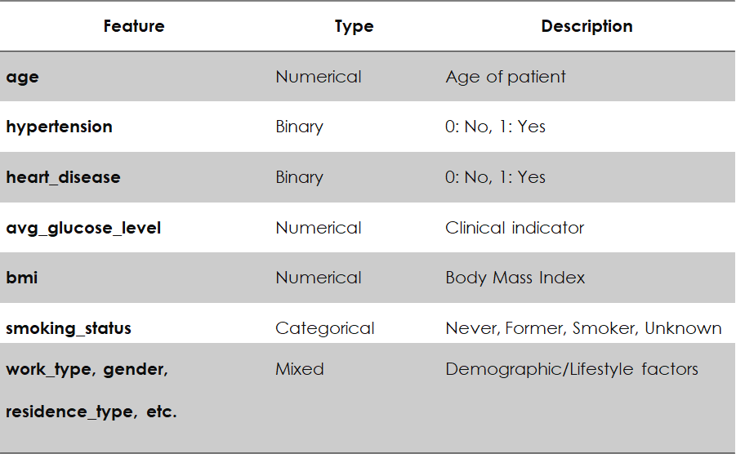
Features in the Dataset
Notes:
The features used for the modeling are presented. We have a combination of demographic, clinical, and behavioral variables. These include age, hypertension status, glucose levels, BMI, and smoking history. Preprocessing such as encoding categorical variables and normalizing numerical ones was essential before training our models.

Slide 6
Handling Imbalance Classes
Stroke (class 1) is underrepresented.
Reflects real-world prevalence (~5%)
Imbalance impacts model learning and evaluation metrics.
Imbalance was addressed using random oversampling technique
Notes:
One major challenge with this dataset is class imbalance. Stroke cases are relatively rare compared to non-stroke cases. This imbalance can bias models towards predicting the majority class leading to missed predictions for high-risk patients. Random oversampling, replicating minority stroke cases to match the majority class.

Slide 7
Methodology Pipeline
Preprocessing:
Categorical encoding
Normalization
Model Training: Each trained on same dataset
Evaluation: Accuracy, Precision, Recall, F1-score, ROC-AUC
Notes:
Our process included data cleaning, encoding categorical features, and scaling. Then, we trained each model and evaluated it using standard classification metrics like accuracy, precision, recall, F1-score, and ROC-AUC. We ensured consistency in input and validation settings across models.

Slide 8
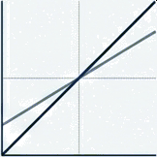



Models Compared
Logistic Regression
Random Forest.
SVC.
XGBoost
Notes:
We tested four machine learning models:
Logistic Regression – Baseline model
Random Forest Classifier – Ensemble with bagging
Support Vector Classifier (SVC) – Margin-based separation
XGBoost – Gradient boosting model with regularization
Each was trained on the same preprocessed dataset to ensure consistency

Slide 9
Model Performance Matrix
Model | Accuracy | Recall (Stroke) | F1 Score | Overfitting Risk
Logistic Reg. | 78% | 81% | 78% | Low
Random Forest | 100% | 100% | 100% | High
SVC | 78% | 83% | 79% | Medium
XGBoost | 93% | 99% | 93% | Low–Medium
Notes:
The results shows that Random Forest and XGBoost dominate in performance, but Random Forest’s perfect score suggest possible overfitting. XGBoost balances performance with practicality. Logistic Regression and SVC provide good recall but don’t match the ensemble methods in overall power

Slide 10
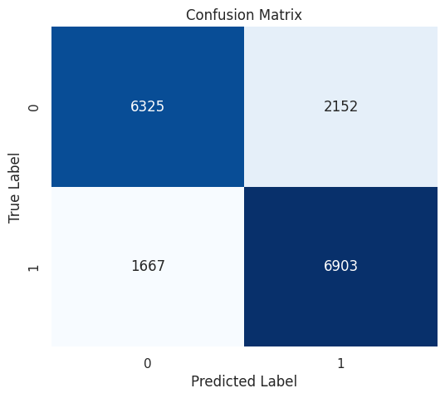
Logistic Regression
Class | Precision | Recall | F1-Score | Support
0 | 0.79 | 0.75 | 0.77 | 8,477
1 | 0.76 | 0.81 | 0.78 | 8,570
Accuracy | - | - | 0.78 | 17,047
Macro Avg | 0.78 | 0.78 | 0.78 | 17,047
Weighted Avg | 0.78 | 0.78 | 0.78 | 17,047
Notes:
The baseline model achieved an accuracy of 78%. Its performance in identifying stroke patients (recall) was 0.81. It also correctly predicted 6,903 stroke cases but missed 1,667. It also misclassified 2,152 non-stroke cases.

Slide 11
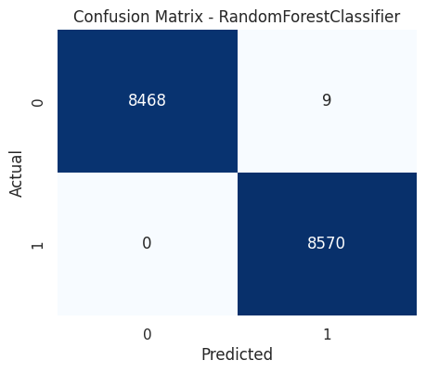
Random Forest
Class | Precision | Recall | F1-Score | Support
0 | 1.00 | 1.00 | 1.00 | 8,477
1 | 1.00 | 1.00 | 1.00 | 8,570
Accuracy | - | - | 1.00 | 17,047
Macro Avg | 1.00 | 1.00 | 1.00 | 17,047
Weighted Avg | 1.00 | 1.00 | 1.00 | 17,047
Notes:
The Random Forest Classifier achieved a perfect score (100%) across all metrics. This indicates overfitting, meaning that the model have memorized the training data rather than generalizing well. It correctly identified all 8,570 stroke cases with zero false negatives and misclassified only 9 non-stroke cases.

Slide 12
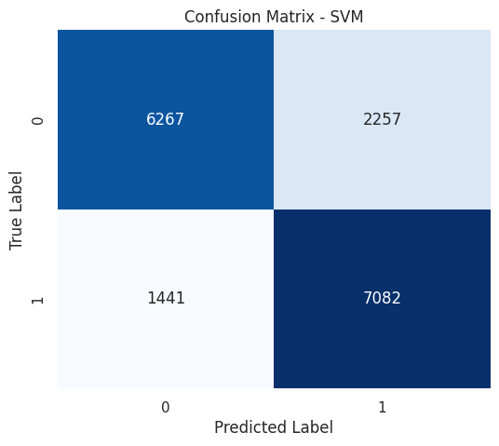
SVC
Class | Precision | Recall | F1-Score | Support
0 | 0.81 | 0.74 | 0.77 | 8,524
1 | 0.76 | 0.83 | 0.79 | 8,523
Accuracy | - | - | 0.78 | 17,047
Macro Avg | 0.79 | 0.78 | 0.78 | 17,047
Weighted Avg | 0.79 | 0.78 | 0.78 | 17,047
Notes:
SVC scored an overall accuracy of 78%, it showed better performance in stroke detection with a recall of 0.83. SVC correctly identified 7,082 stroke cases but missed 1,441. It also misclassified 2,257 non-stroke cases.

Slide 13
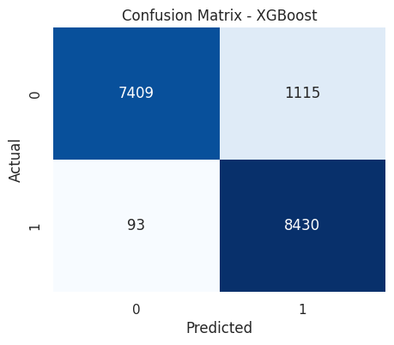
XGBoost
Class | Precision | Recall | F1-Score | Support
0 | 0.99 | 0.87 | 0.92 | 8,524
1 | 0.88 | 0.99 | 0.93 | 8,523
Accuracy | - | - | 0.93 | 17,047
Macro Avg | 0.94 | 0.93 | 0.93 | 17,047
Weighted Avg | 0.94 | 0.93 | 0.93 | 17,047
Notes:
XGBoost achieved 93% accuracy and a recall of 0.99 for stroke cases. That means it was extremely sensitive in identifying patients at risk. Out of over 17,047 instances, it correctly predicted 8,430 stroke cases with only 93 false negatives. While it misclassified 1,115 non-stroke cases as strokes.

Slide 14
Lessons Learned
We learned that:
XGBoost offers the best trade-off between accuracy and recall.
Ensemble models are robust but require careful tuning.
Classical models such as Logistic Regression still hold value for their simplicity and transparency.

Slide 15

Thank You / Q&A

